Slide 1
Direct Numerical Simulation of Low-Mach Reacting Gas-Solid Flows Using a Penalization Method
B. Hardy, G. Winckelmans, J. De Wilde
August 7th, 2018

Slide 2
Outline
Motivation
Methodology
Incompressible case
Weakly compressible case
Intra-particular description
Conclusion & perspectives

Slide 3
1. Motivation
Gas-solid flow modelling: need for closure laws for mass, momentum and heat transfer (1-D, two-fluid or discrete element model)
DNS: powerful tool to derive transfer laws from
fundamental conservation laws
Currently: most DNS works based on
  incompressible assumption
  0-D description of the particle
Missing information :
how transfer laws are impacted by
  Density fluctuations (thermal effects, cracking,…)
  Intra-particle diffusional limitations
  Catalyst deactivation
  Change of size (shrinking / growth) ?
Heat ?
Mass ?
Momentum ?

Slide 4
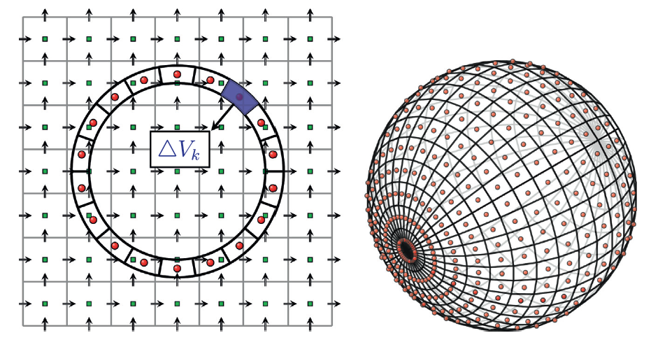




2. Methodology
Proposed Immersed Boundary Method : Penalization Method
→ the solid phase is described as a porous medium with very small permeability
Classical IBM
Particle tracked with Lagrangian surface points
Volume penalization method
Mask (0 or 1) to locate the solid
phase
$$χ=0$$
$$χ=1$$
$$χ=1$$
$$χ=1$$
Reproduced from ﻿H. Tavassoli et al., IJMF 57 (2013) 29–37
Adapted for low-moderate particle Reynolds number (typical for fluidized beds)
Adapted for moving particles
Ease of implementation

Slide 5
Weakly compressible formulation
Density fluctuations at the surface of the particle induced by
  Heat release / consumption
  Molecular weight change (A → B+C or A + B → C)
Fully compressible Navier-Stokes equations : time step limited by acoustic waves
Weakly compressible formulation (or ”low Mach”) : allows to account for variable density while taking out acoustic modes
Valid if
typically verified in most industrial operation conditions !

Slide 6
3. Incompressible case
Penalization Method :
  in the fluid ( ) : solve classical N-S equations
  in the solid ( ) : add a forcing term which enforces the Dirichlet boundary conditions
  e.g. no slip, fixed temperature and composition on the surface of the solid phase

Slide 7
Incompressible penalized Navier-Stokes equations

Slide 8
Accuracy and stability
Accuracy controlled by
the numerical solution tends towards the exact one as
with a convergence rate (see Carboue and Fabrie, Advances in Dierential Equations, 2003)
Stability : constraint on
e.g. Euler Explicit scheme, stability constraint :
→ very constraining on the time-step if we want to choose !
Implicit scheme with matrix inversion ?
No additional cost : the penalization term is local and linear !
→ diagonal matrix
→ therefore we can choose with
e.g.

Slide 9
Moving particle : solid phase equations
Euler-Newton equations
Force evaluation can be performed by integrating the penalization term over the particle volume (instead of its boundary)

Slide 10
Moving particle : collision model
Glowinski repulsion force model (Glowinski & al., JCP, 2001) further improved by Feng & Michaelides (Feng & Michaelides., JCP, 2005)
Soft-sphere based model : motion laws are integrated during the entire collision process

Slide 11
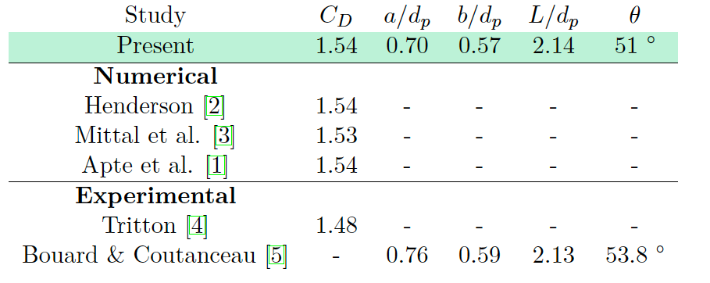
Validation : hydrodynamics
2-D flow past a disk :

Slide 12
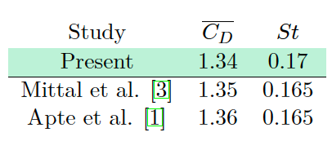
Validation : hydrodynamics
2-D flow past a disk :
Notes:
St = Strouhal number : St = f*dp / U. f is the frequency of the LIFT coefficient oscillations
Vorticity field : von-Karman vortices properly captured

Slide 13
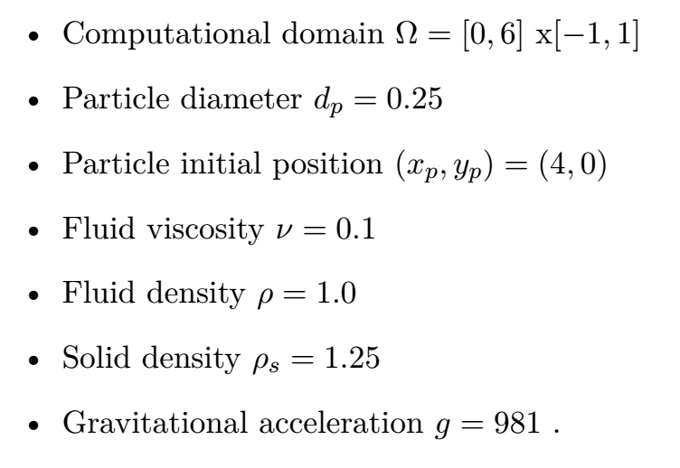
Validation : fluid-structure coupling
Sedimentation of a disk in a vertical channel
Glowinski test case :
(Glowinski & al., JCP, 2001)
Good agreement with
Glowinski terminal velocity :

Slide 14
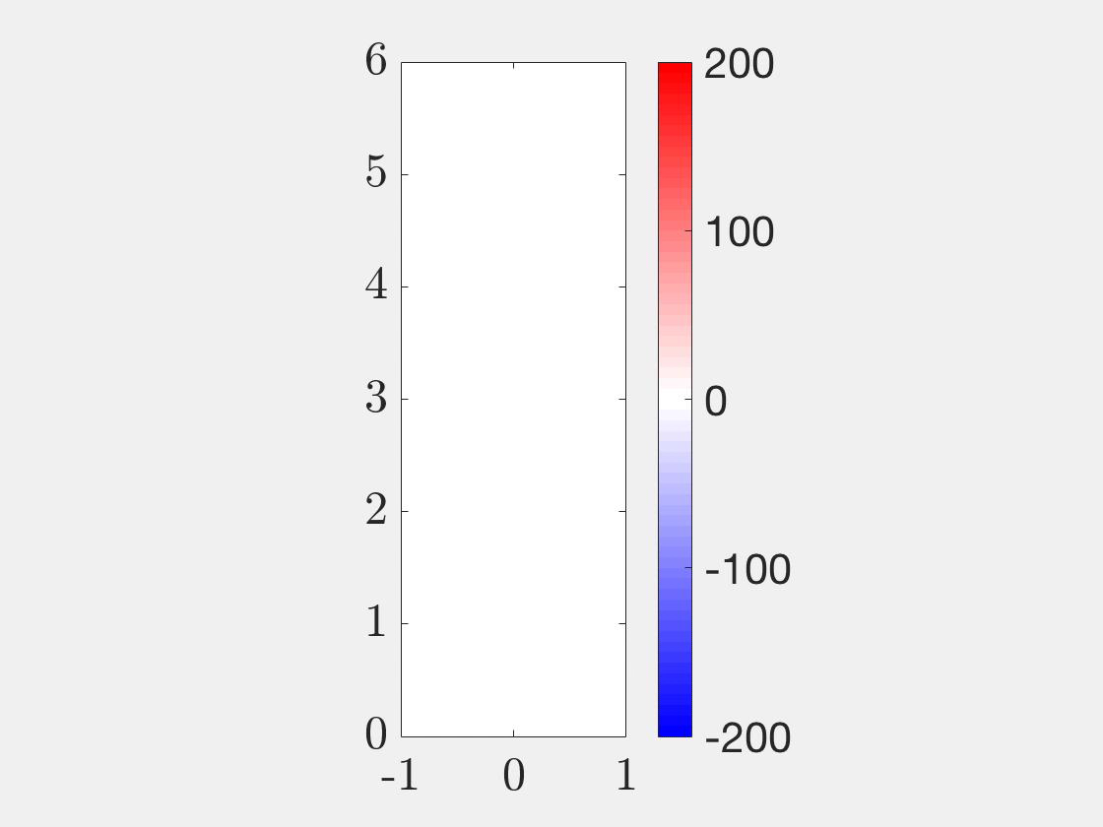
Validation : fluid-structure coupling
Sedimentation and interaction of two disks in a vertical channel
= Drifting-Kissing-Tumbeling (DKT) test case
Notes:
Vorticity iso-contour: Drifting kissing tumbeling phenomenon. Upper particle falls faster because in the wake of the lower one. Then collision : the two particles form an elongated body which tumbles to face the flow perpendiculary

Slide 15
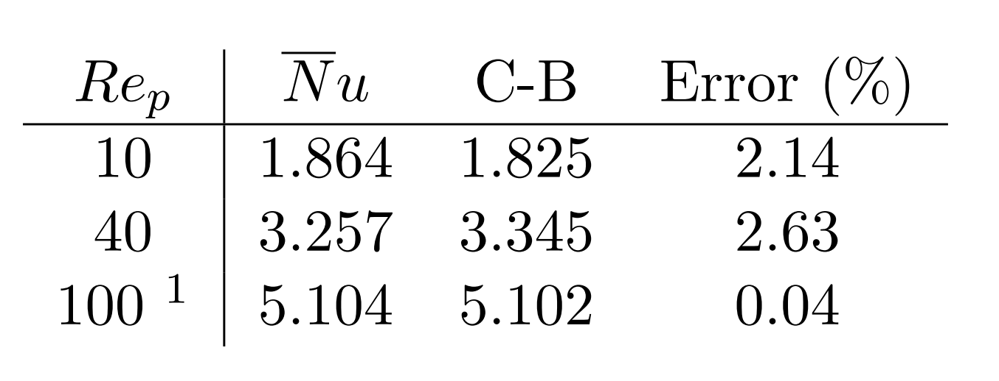
Validation : heat and mass transfer
Flow past a fixed disk with imposed constant temperature and zero surface concentration (isothermal, infinitely fast reaction)
Extract average Nusselt number and validate vs. Churchill-Bernstein correlation
Good agreement

Slide 16
4. Weakly compressible case
Assumption : flow velocities are low compared to the speed of sound
→
A dimensional analysis of the fully compressible N-S equations shows¹ that the gradient of the pressure is of order
→ pressure can be decomposed as a spatially uniform thermodynamic background pressure, , and a fluctuating hydrodynamic pressure, :
When , we have a simplified state law
used to update density
Domain with an open boundary :

Slide 17
Penalized low Mach Navier-Stokes equations
= 0 in an open domain
Conversely to the incompressible case, we need to penalize the mass conservation law, using a porosity (stability issue)

Slide 18
Forced convection ( ) with fixed temperature at the surface ( ): density field contour
Density inside the particle = density of the pseudo-fluid which mimics the particle behavior, at the particle temperature
Extract Nu number for comparison vs. incompressible case
→ Fully incompressible simulations overestimate the heat transfer efficiency
Notes:
T0 = inlet Temperature and initial condition in the entire domain
Nusselt number slightly larger in the fully incompressible case → over-estimate the heat transfer efficiency

Slide 19
5. Intra-particular description
Idea: since we have a mask to follow the solid phase, we can use it to solve in on one pass:
  The scalar advection-diffusion equation in the fluid phase
  The diffusion-reaction equation in the solid phase
The species and continuity equations becomes
(similar for energy equation)
The diffusion coefficient is discontinuous at the particle surface : ensures flux continuity
The intra-particular profiles are computed on the background Eulerian grid → computational cost is !
Notes:
Computational cost in O(1) means that solving the profiles for 1 particle or 1000 particles has the same cost since the fluid solver goes across the entire grid

Slide 20
Test case: forced convection at , first-order kinetics, different Damköhler numbers
Da = 0.01
Da = 0.1
Da = 1
Notes:
Damkhöler number = 0.1

Slide 21
Radial profile comparison vs. analytical solution for a 1-D diffusion reaction equation with imposed surface concentration and zero gradient at the center
Discrepancy reasons :
  Not strictly identical problems (forced convection vs. fixed concentration)
  Radial distance captured in 15 grid points
  = qualitative validation

Slide 22
5. Conclusion & perspectives
New methodology combining the penalization method and the low-Mach number assumption: attractive for low to moderate particle Reynolds number flows with variable density
Thorough validation of the incompressible case
Intra-particular description allowing a fully multi-scale resolution
Future investigations:
3-D extension
Shape-changing particle (growth/shrinking)
Real-life reaction rates (cracking, combustion,…)
Assessment of the impact of the variable density on meso-scale transfer laws

